Slide 1
Financial Control
Group 5 :
Josh Carlson
Max Breyer
Kevin Barrett
Jeff Mcdonald
Eyasu Asrat

Slide 2
Our Competition
Conservative
Asset Class
Allocation
T
ime Horizon:
Return:
Expensive
Polished
Automatic
Under 3­5 years
(1970­2015)
Large Cap Equity
15.00
%
•
W
ant current
•
A
verage Annual
income and
Return: 7.7%
Small Cap Equity
0.00
%
stability
•
Best Y
ear: 22.8%
•
Not concerned
•
W
orst Y
ear:
5.00
about increasing
International Equity
%
­4.6%
the value of your
Fixed Income
50.00
investments
%
Cash Investments
30.00
%
Other
0.00
%

Slide 3
Our Plan
Ask user for how their money is invested across broad catagories
Ask user for how they would like to distribute their money
Provide guidance for how to reach their goals only by changing future investments

Slide 4
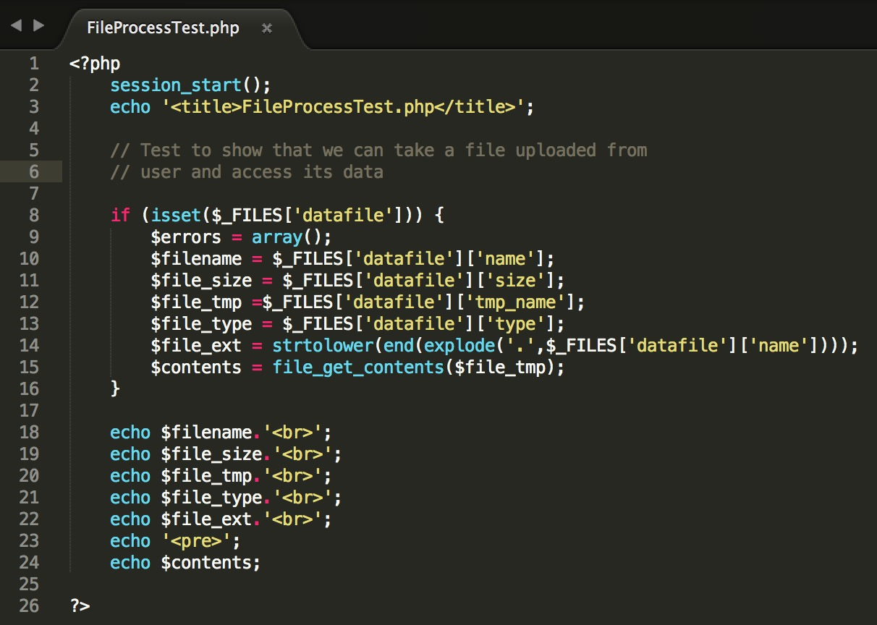
PHP script will transfer data between HTML form and SQL database

Slide 5
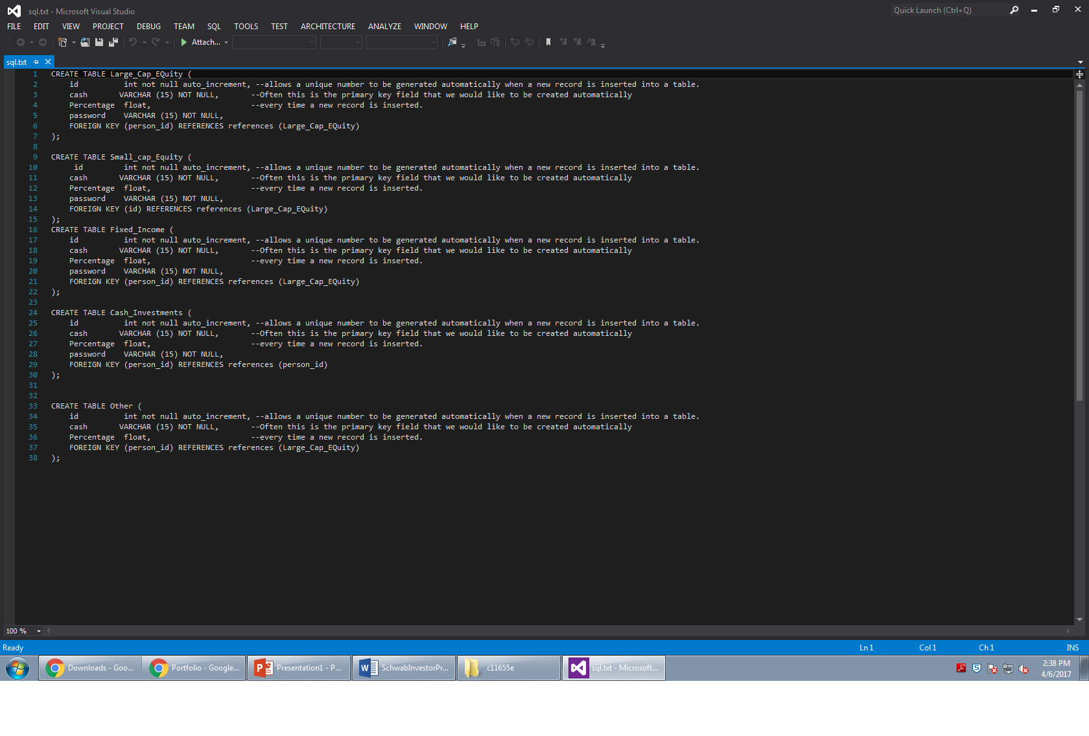
Database
Stores data during website use and export to tab delimited file for storage
Let user store their own sensitive data

